Slide 1
Revision INFO

Slide 2
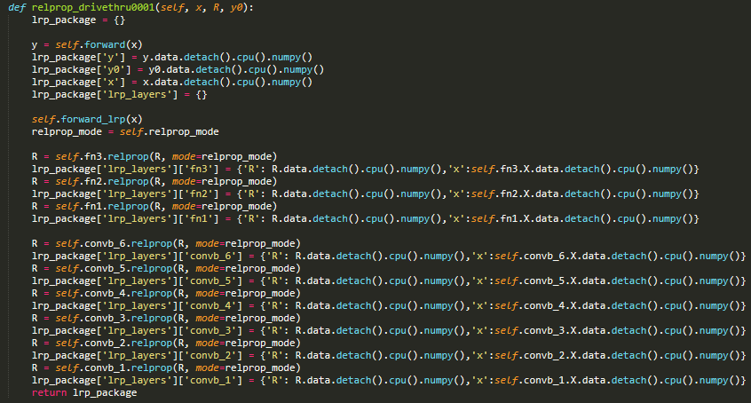
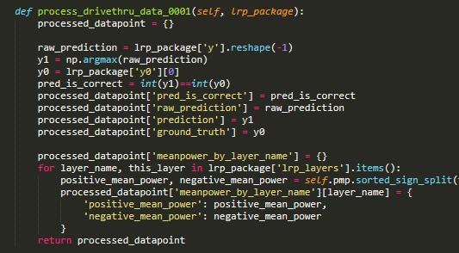
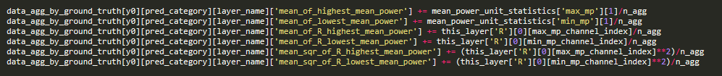


IF DT Eval
if (total_iter_in_this_run+1)
% eval_every_n_iter == 0
Data by iter
save_data_by_iter_details[n_epoch+1][total_iter+1]
IF j <= n_LRP
if j <= n_of_test_data_per_LRP_eval:
CHANGED AFTER REVISED 1
eval
Lrp_package
LRP
Training
IF j <= n_LRP
process_drivethru_data_0001
IF DT Eval
processed_datapoint
$$x,y$$
$$x_{test},$$
$$y_{test}$$
data_agg_by_ground_truth
process_drivethru_data_0002
{
‘groundtruth’:{‘pred_category’: {‘layer_name’:{DATANAME}}}
}
NetProbe
Data by iter

Slide 3
IF DT Eval
if (total_iter_in_this_run+1)
% eval_every_n_iter == 0
Data by iter
save_data_by_iter_details[n_epoch+1][total_iter+1]
IF j <= n_LRP
if j <= n_of_test_data_per_LRP_eval:
eval
Lrp_package
LRP
Training
IF j <= n_LRP
process_drivethru_data_0001
IF DT Eval
processed_datapoint
$$x,y$$
$$x_{test},$$
$$y_{test}$$
NetProbe
Data by iter

Slide 4
Revision 1 Post-sequence notes:
MNIST batch_size=4 achieves >0.9 acc
SmallNet: 20k+ iters,
AlexNet: 10k+ STUCK AT CONVB1, NON-FINITE VALUE!
vggNet: 5k+
CIFAR at 50k iters
SmallNet: ~0.45
AlexNet: ~0.65 STUCK AT fn1, NON-FINITE VALUE
vggNet: ~0.6 STUCK AT CONVB1, NON-FINITE VALUE
See smallCNN_probe.py
mean_of_highest_mean_power and mean_of_lowest_mean_power
might not be necessary to plot

